Slide 1
Adaptations of Shakespeare’s works
Lovro Oreški, 3.c

Slide 2
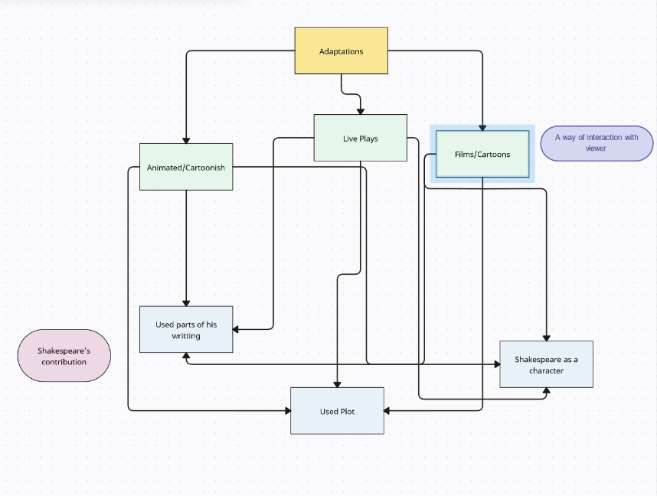
General classification

Slide 3
List of examples
West Side story
The Lion King
Get Over it

Slide 4
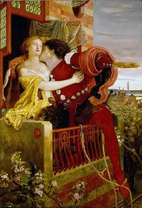

West Side Story
American musical romantic drama film
Inspired from ShakeSpeare’s “Romeo and Juliet”
Contains Shakespeare’s “A Lover’s Complaint”

Slide 5

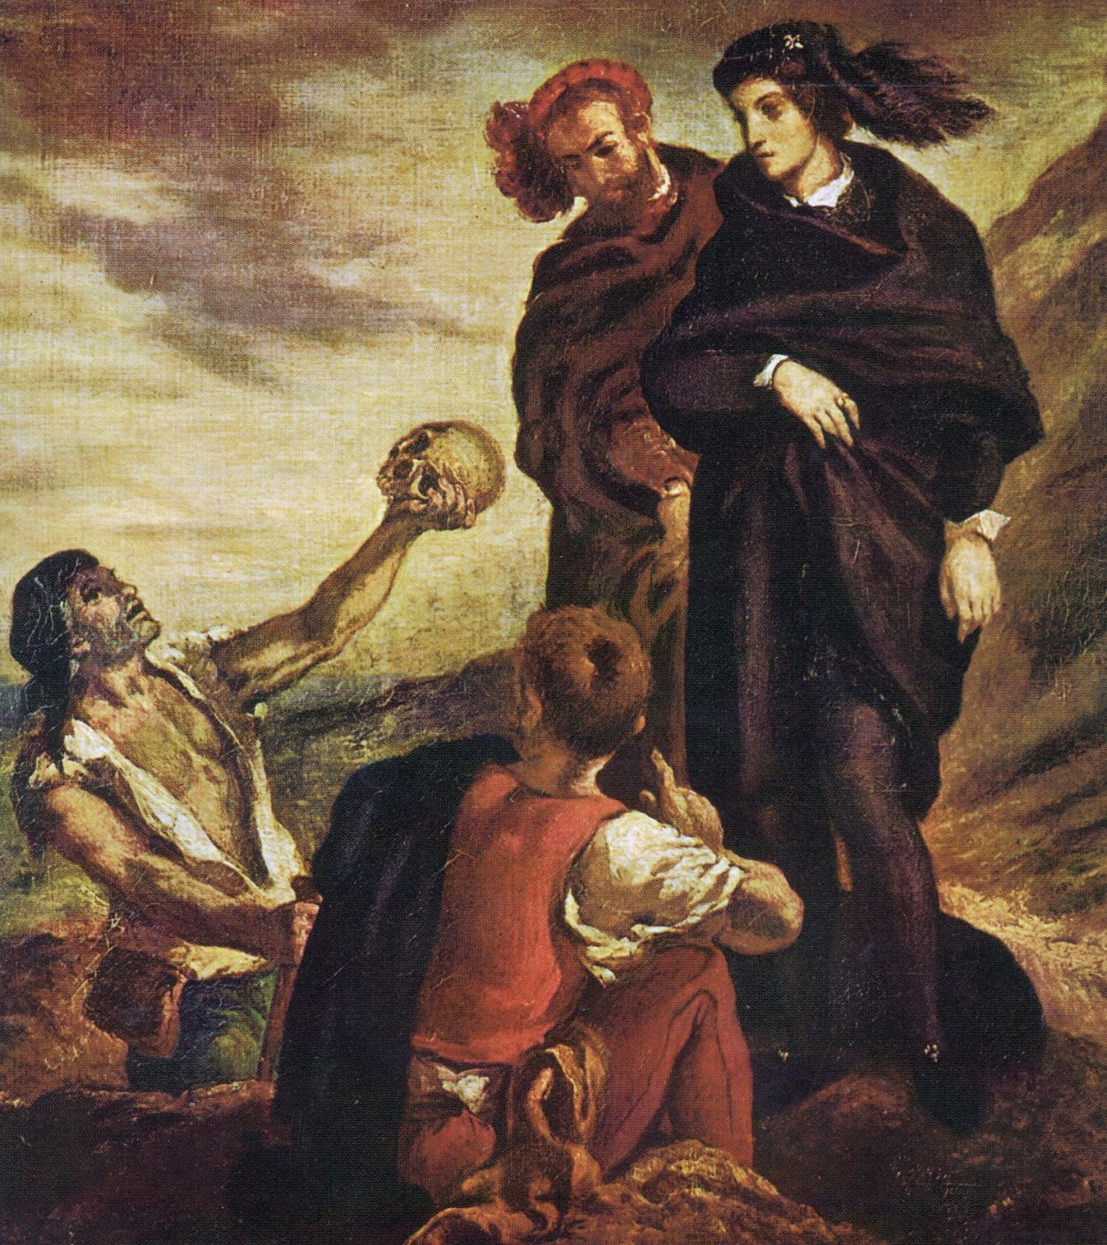
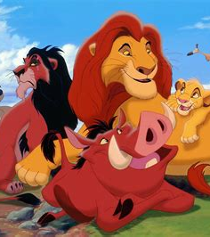
The Lion King
American musical drama animations
Inspired from Shakespeare’s “Hamlet”

Slide 6


Get Over it
American teen comedy film
Inspired from Shakespeare’s “A Midsummer Night’s dream”

Slide 7
Conclusion…

Slide 8

Sources
https://benjaminmcevoy.com/adapt-shakespeare-john-dryden-case-study/
https://www.oxfordbibliographies.com/display/document/obo-9780199846719/obo-9780199846719-0196.xml
https://en.wikipedia.org/wiki/West_Side_Story
https://en.wikipedia.org/wiki/Hamlet
https://www.folger.edu/explore/shakespeares-works/hamlet/read/
https://en.wikipedia.org/wiki/List_of_William_Shakespeare_screen_adaptations
https://collider.com/best-movies-based-shakespeare-plays/
https://www.timeout.com/film/the-25-best-shakespeare-to-screen-adaptations
https://www.denofgeek.com/culture/15-great-adaptations-of-shakespeare/
https://en.wikipedia.org/wiki/Category:Adaptations_of_works_by_William_Shakespeare
https://en.wikipedia.org/wiki/Romeo_and_Juliet
https://www.britannica.com/topic/Romeo-and-Juliet
https://en.wikipedia.org/wiki/Get_Over_It_(film)
https://en.wikipedia.org/wiki/Midsummer
https://en.wikipedia.org/wiki/Film_genre
https://www.studiobinder.com/blog/movie-genres-list/
https://translate.google.com/?hl=hr&sl=hr&tl=de&op=translate
https://en.wikipedia.org/wiki/My_Own_Private_Idaho
https://en.wikipedia.org/wiki/Henry_V_(play)
https://www.sparknotes.com/shakespeare/romeojuliet/characters/
https://www.personalitycafe.com/threads/shakespearean-characters.135692/
https://en.wikipedia.org/wiki/Shakespeare's_plays

